Slide 1
Replicate, Walk, and Stop on Syntax: An Effective Neural Network Model for Aspect-Level Sentiment Classiﬁcation
汇报人：Chaoyan Fu
时间：2021.1.31
Conference：AAAI-2020
Github:https://github.com/hiyouga/RepWalk.

Slide 2
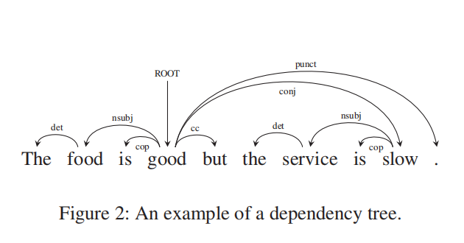
Motivations
The dependency tree is an important syntactic structure which establishes relationships between “head” words and words which modify those heads. Therefore, it can easily model the syntactic interrelationship between each contextual word and the aspect term.
The contextual features of the informative words on the subtree of the dependency tree may contribute significantly to identify the sentiment expressed on the specific aspect in the sentence.

Slide 3
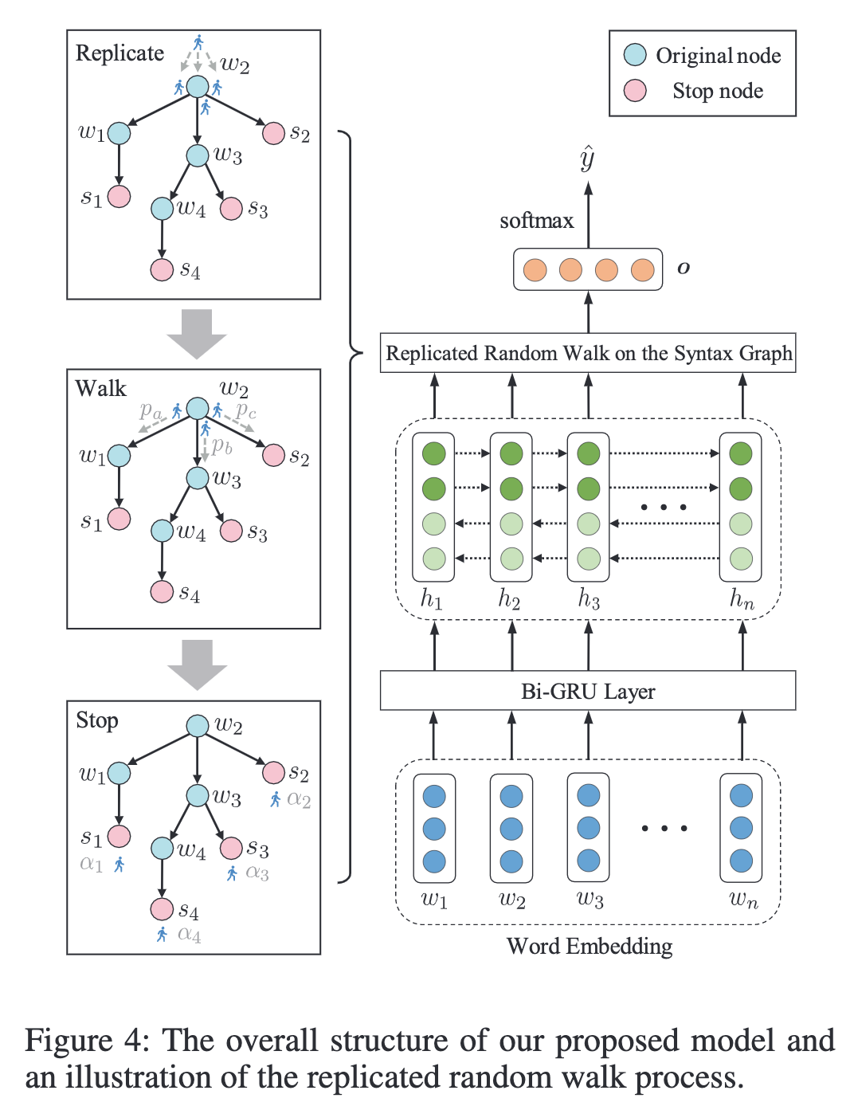
Model Architecture
RepWalk, a novel neural network for aspect-level sentiment classiﬁcation. The RepWalk performs a replicated random walk on the syntax graph for learning a better sentence representation.
The learning problem can be understood on the behavior of an agent traversing from the root node of the syntax graph, replicating itself on each node, with the aim to traverse on all available routes reaching a stop node with some probability. The word wi will be highlighted if a replica manages to traverse onto the stop node si along the path in the syntax graph.
Notes:
在句法图的帮助下，为了有效地发现 informative contextual words ，我们为 ABSA 任务制定了 random walk 的规则。学习问题可以理解为一个代理 (agent) 从句法图的根节点开始遍历，在每个节点上复制 (replicate) 自己，目的是以某种概率遍历到达 stop node 的所有可用路由 (routes) 。如果副本沿着句法图中的路径遍历到 stop node $s_i$，$w_i$ 这个词将突出显示。我们把这种遍历称为 replicated random walk 。
Replicated random walk 过程包含三个部分：Replicate，Walk，Stop。

Slide 4
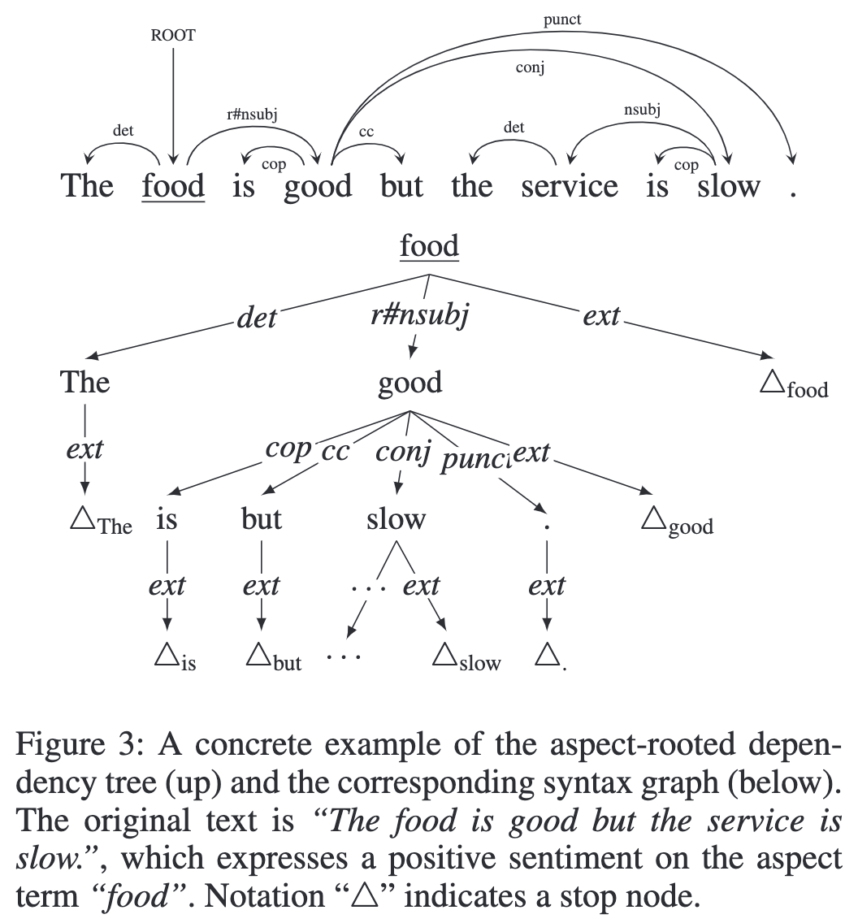
Model Architecture

Slide 5
model
Because there may be multiple paths connecting the informative words on the subtree of the dependency tree, only one agent cannot attend to all paths. To address this problem, the agent replicates into a total of d copies at each node, where d is the number of the downstream edges of this node.

Slide 6
model
Notes:
节点 $j \in \mathcal{V}$ 的表示为 $q_j \in \mathbb{R}^{d_q}$ 。对于任意给定的 edge $e=(u,r,v) \in \mathcal{E}$ ，连接 node $u \in \mathcal{V}$ 到 $v \in \mathcal{V}$ ，$r \in \mathcal{R}$ 是 edge 标签，$r$ 的 embedding 为 $\theta_r \in \mathbb{R}^{d_r}$ 。我们定义一个函数 $p(e)$ 将每个 edge $e$ 映射到一个概率值：

Slide 7
model

Slide 8
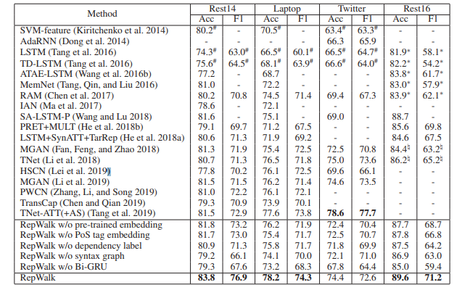
Experiment

Slide 9
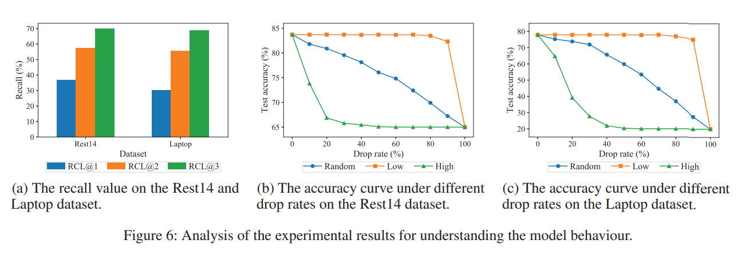
Experiment

Slide 10
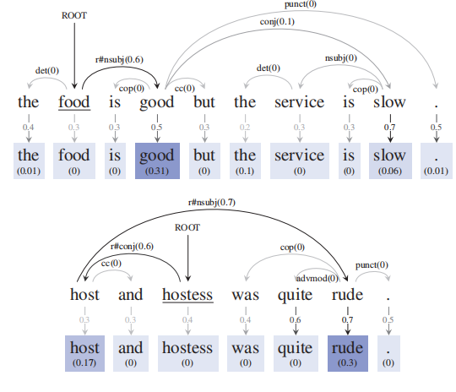
Experiment

Slide 11
THANGKS!

